Slide 1
Enfield Black Health Forum:
Launch event
Duduzile Sher Arami
Director of Public Health,
London Borough of Enfield
Striving for excellence
www.enfield.gov.uk

Slide 2
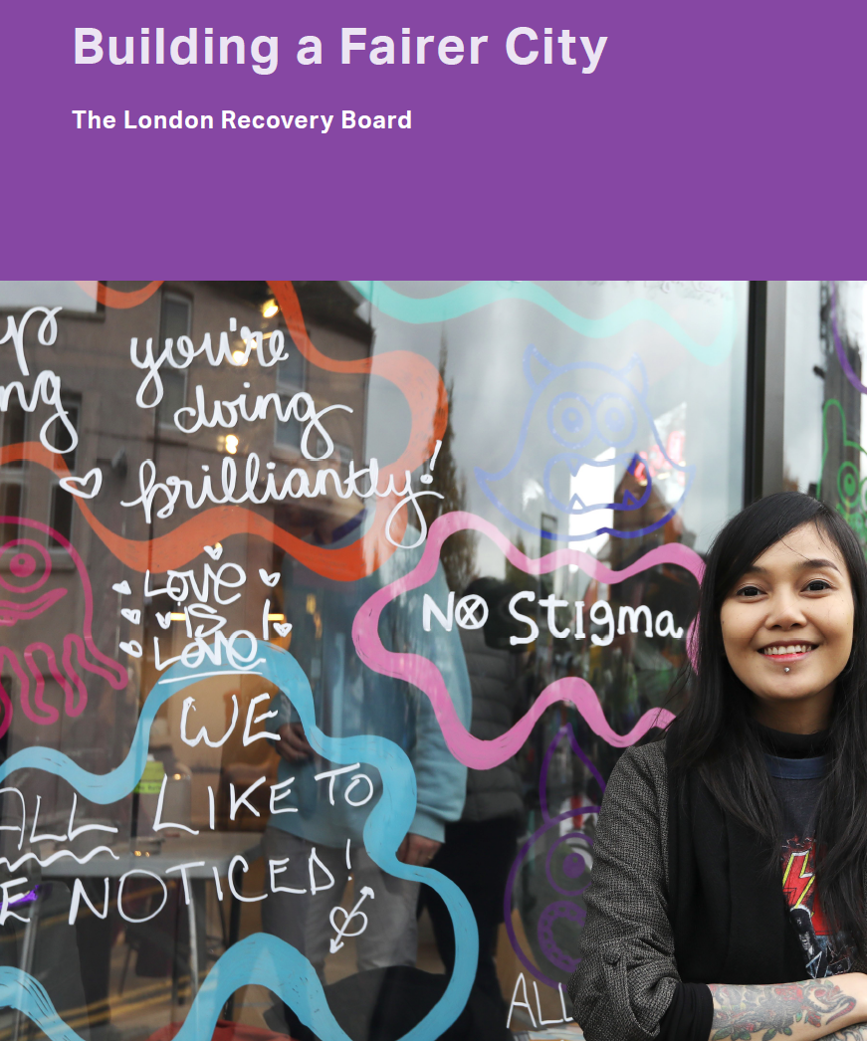
Our city is strong, and abundant in its diversity of skills, talent and energy, and together we have the potential to create change that is striking, positive and enduring.

Slide 3
What are we talking about today?
FAIRNESS
COMMUNITY ASSETS
HEALTH BEHAVIOURS
STRENGTHS
WORKING TOGETHER
HEALTH DISPARITIES
INEQUALITIES
FACTORS THAT INFLUENCE WELLBEING
RACISM
DISCRIMINATION

Slide 4
What do we know about the wellbeing of Black Communities in Enfield?
The way ethnicity data is collected/ recorded in health and social care makes it difficult to understand needs.
Impact of COVID
Poverty
Lifestyles that maintain health
Long Term Conditions
Access to services

Slide 5
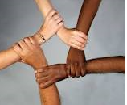
What do we know about the wellbeing of Black Communities in Enfield?
But we also know………

Slide 6
What are we doing as a borough?
Working collectively
Inequalities Workstream
Community Participatory Research
Community Chest
Funded community projects including Black Health Forum

