Slide 1
Enfield COVID Engagement
Riyadul Karim
Assistant Director of Primary Care, North Central London CCG, Enfield
28 May 2022

Slide 2
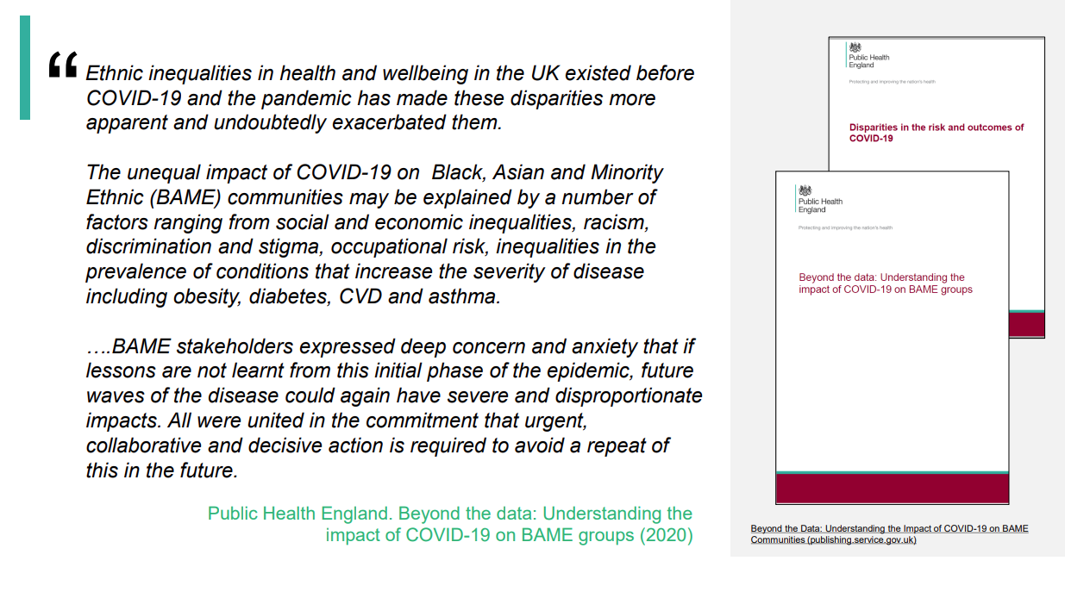
COVID - Disproportionate Impact
Over the summer 2020 Enfield Council, NCL CCG, community and acute providers and VCSE sector were all concerned about the disproportionate impact of COVID-19 on Black and Asian communities and keen to understand the learnings and also implement the recommendations from the Public Health England reports on Disparities in the risk and outcomes of COVID-19 and Beyond the data: understanding the impact of COVID-19 on BAME (led by Prof Kevin Fenton)
.

Slide 3
Enfield Borough Partnership
There is strong evidence that the pandemic didn’t affect all population groups equally. Ethnic minorities were more likely to acquire the virus and suffer worse outcomes.
Vaccine hesitancy is widening those inequalities and will have negative heath impacts for years to come.
Stakeholders came together at borough partnership level to collaborate on support COVID-19 awareness and then afterwards promoting vaccination with the communities in Enfield
Interdisciplinary group of local stakeholders and partners think strategically and act operationally about how to improve vaccination uptake and seeking to understand the principal issues and concerns in the communities and working collaboratively to reduce vaccine inequalities especially in communities with the lowest uptake
Enfield Borough Partnership established Covid Vaccine Inequalities Group to take oversight of local provision, and to reduce inequality in vaccine uptake (between areas of high and low deprivation, different ethnic groups, Under 40s and other groups experiencing deprivation and lower uptake e.g. Black African and Black Caribbean, East European, and Gypsy Roma Traveller communities)
The LBE Enfield Public Health Intelligence Team provide regular analysis to the Covid Vaccine Inequalities Group on vaccine uptake by age, sex, ethnicity, geography and language spoken. This has informed location of pop ups, community engagement, webinars and media work etc to inform vaccine uptake. Covid Vaccine Inequalities Group oversees a programme of communication and engagement activity aiming to provide accurate information from trusted sources, this being undertaken by NCL CCG Enfield, CCG and LBE Communications.
Webinars focused on language groups, ethnicities (Black African and Black Caribbean, Turkish and Bulgarian speaking etc), parents, specific staff groups and a vaccination summit involving national leaders: Dr Bola Owolabi NHSE/I Director of Inequalities and Professor Kevin Fenton
.

Slide 4
Webinar in February 2021
Notes:
Dr Bola Owolabi, GP, Director of Health Inequalities NHS England and NHS Improvement (NHSE/I)
Dr Habib Naqvi, MBE, Director, The NHS Race and Health Observatory
Qari Asim, MBE, Imam, Chair of Mosques and Imams National Advisory Board, Legal Director, DLA Piper
Marcus Riddell, Head of Equality and Inclusion – Evidence and Policy; Staff Vaccinations – Covid-19 Workforce Cell, NHSE/I
Dr Farzana Hussain, GP, Co-Chair of National PCN network at NHS Confederation and PCN clinical Director Newham Central 1
Dr Masood Ahmed, Chief Medical Officer, NHS Black Country & West Birmingham CCGs
Dr Fahim Chowdhury, GP and Primary Care Clinical lead, Enfield, NHS North Central London CCG
Dr Nitika Silhi, GP and NHS North Central London CCG Elected Governing Body Member, Enfield
Riyad Karim, Interim Head of Primary Care Commissioning, Enfield, NHS North Central London CCG
Emily Burch, Head of Physical Health, Lead for COVID-19 Test, Barnet, Enfield and Haringey MH Trust
Dudu Sher-Arami Consultant in Public Health, Peoples Directorate, London Borough of Enfield

Slide 5
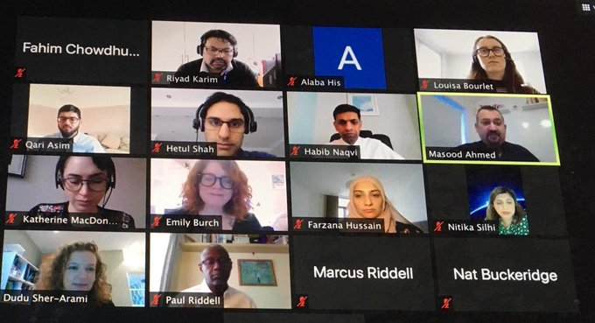
February 2021 Webinar Team
Notes:
Dr Bola Owolabi, GP, Director of Health Inequalities NHS England and NHS Improvement (NHSE/I)
Dr Habib Naqvi, MBE, Director, The NHS Race and Health Observatory
Qari Asim, MBE, Imam, Chair of Mosques and Imams National Advisory Board, Legal Director, DLA Piper
Marcus Riddell, Head of Equality and Inclusion – Evidence and Policy; Staff Vaccinations – Covid-19 Workforce Cell, NHSE/I
Dr Farzana Hussain, GP, Co-Chair of National PCN network at NHS Confederation and PCN clinical Director Newham Central 1
Dr Masood Ahmed, Chief Medical Officer, NHS Black Country & West Birmingham CCGs
Dr Fahim Chowdhury, GP and Primary Care Clinical lead, Enfield, NHS North Central London CCG
Dr Nitika Silhi, GP and NHS North Central London CCG Elected Governing Body Member, Enfield
Riyad Karim, Interim Head of Primary Care Commissioning, Enfield, NHS North Central London CCG
Emily Burch, Head of Physical Health, Lead for COVID-19 Test, Barnet, Enfield and Haringey MH Trust
Dudu Sher-Arami Consultant in Public Health, Peoples Directorate, London Borough of Enfield
This ICP Communities Webinar on the COVID-19 vaccine is borne from realisation that uptake of COVID-19 needs to be connected firmly within the context of health inequalities, the need to narrow the gap, recognition of the disproportionate impact of COVID-19 on BAME communities.

Slide 6
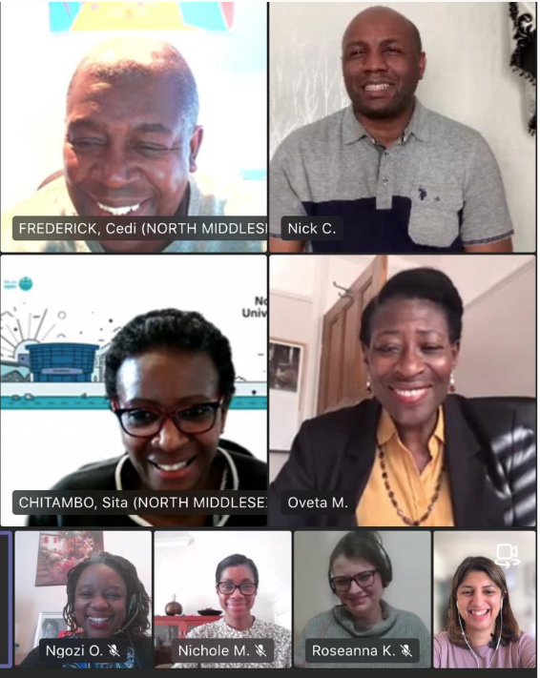
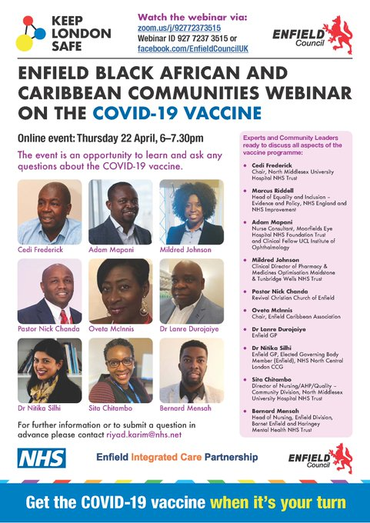
Webinar in April 2021
Notes:
Great to convene a team to discuss covid vaccine webinar for Enfield Black African and Caribbean Community

Slide 7
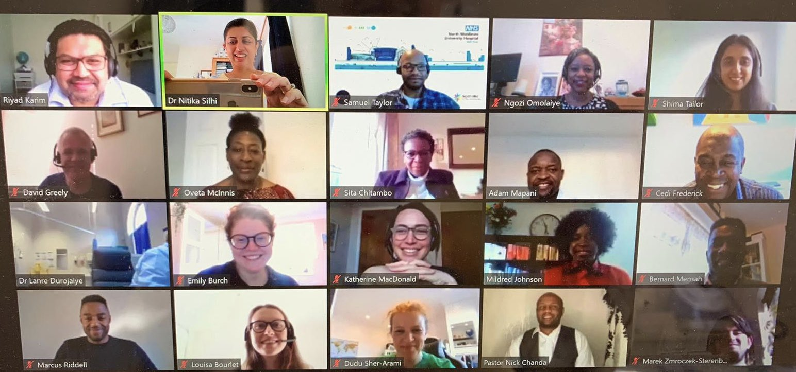
April 2021 Webinar Team
Notes:
Great to convene a team to discuss covid vaccine webinar for Enfield Black African and Caribbean Community

Slide 8
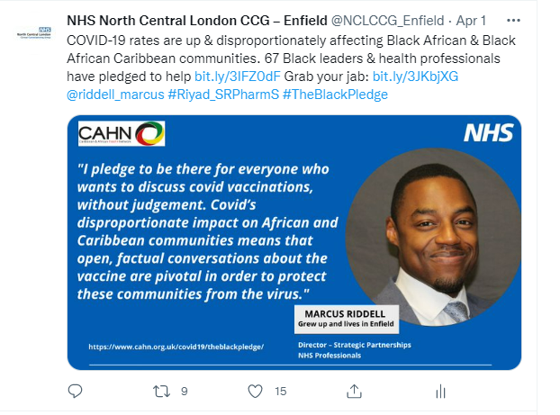
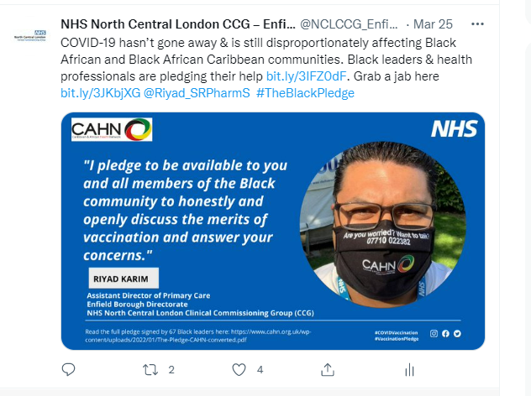
The Pledge April 2022
Working with CAHN to promote black leaders and professionals pledging to reach out to Black African and Black Caribbean communities

Slide 9
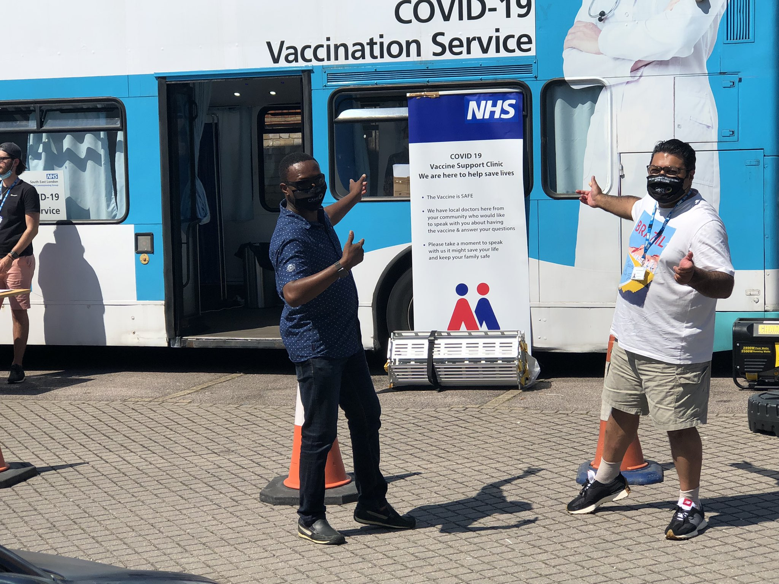
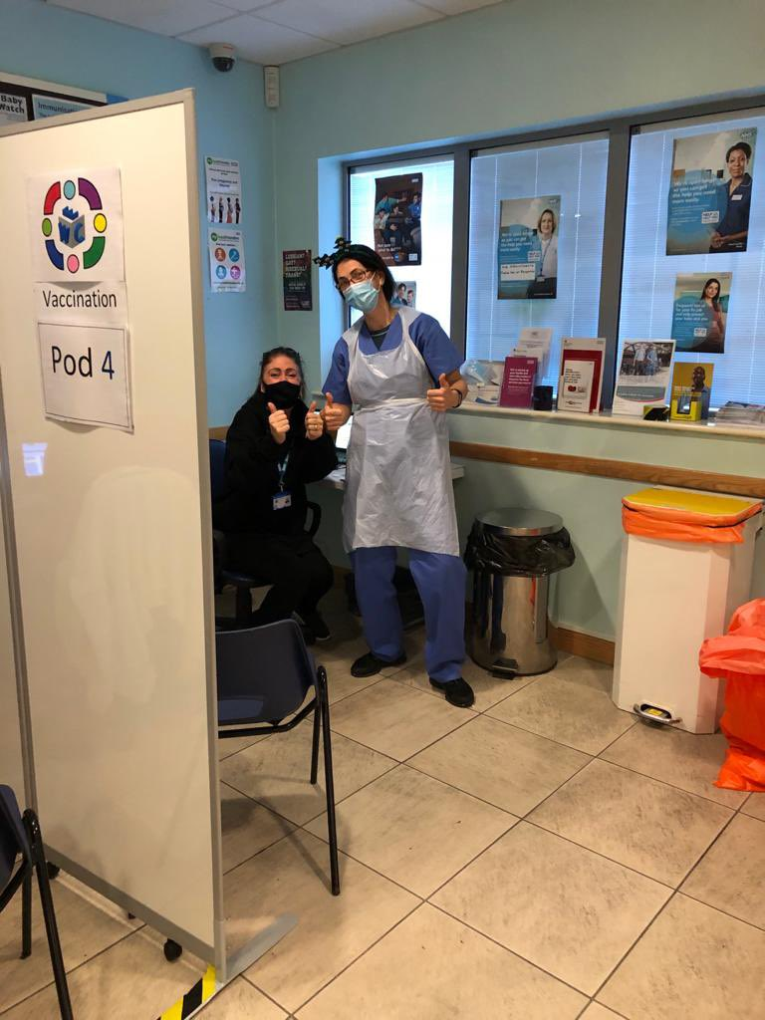
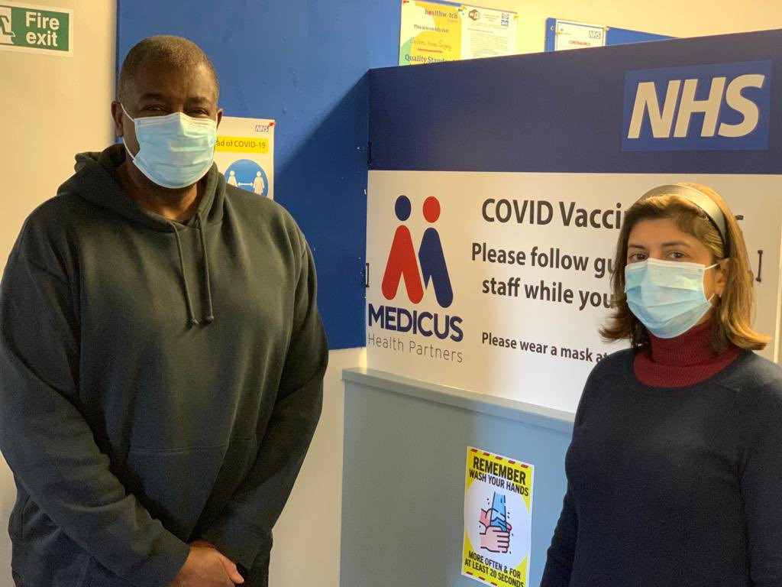
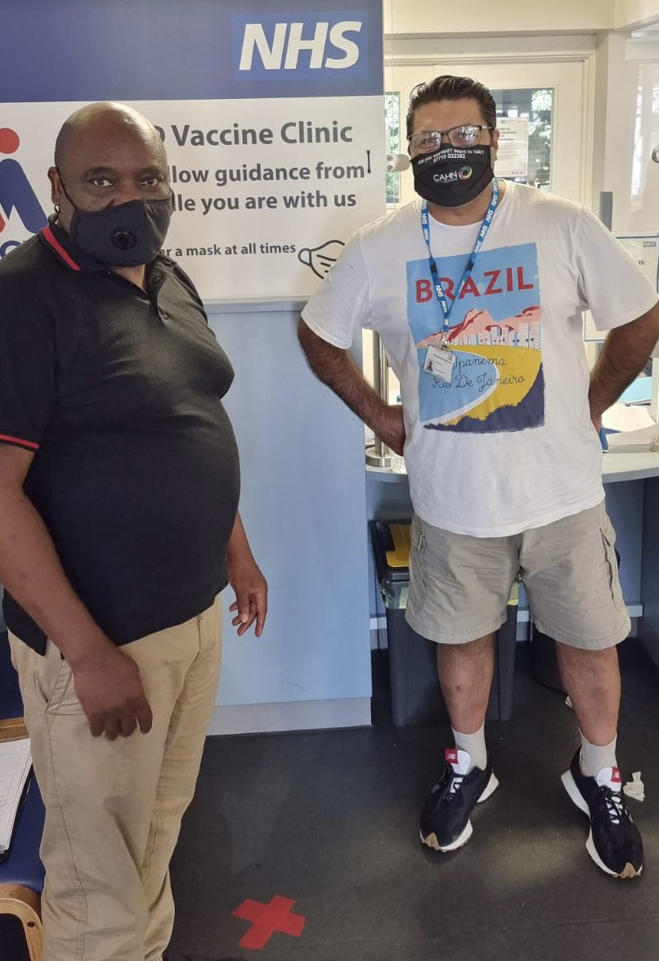
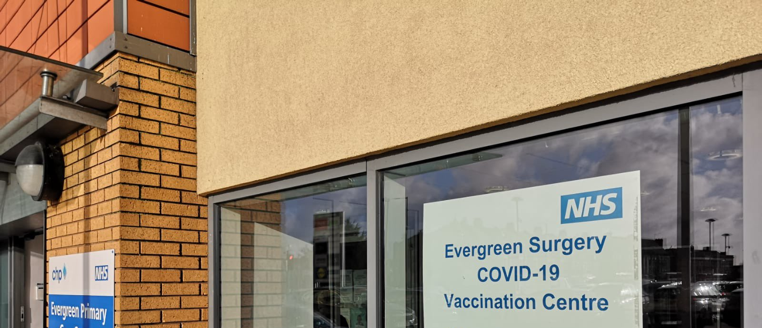
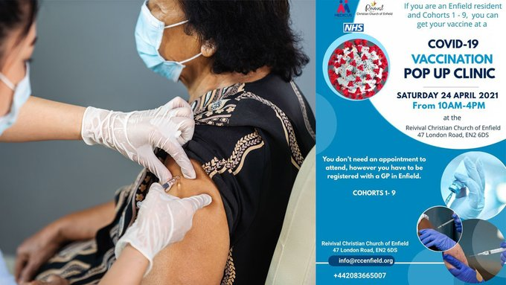
Enfield Vaccination

Slide 10
Black Health Improvement Programme – Feb 2022

Slide 11
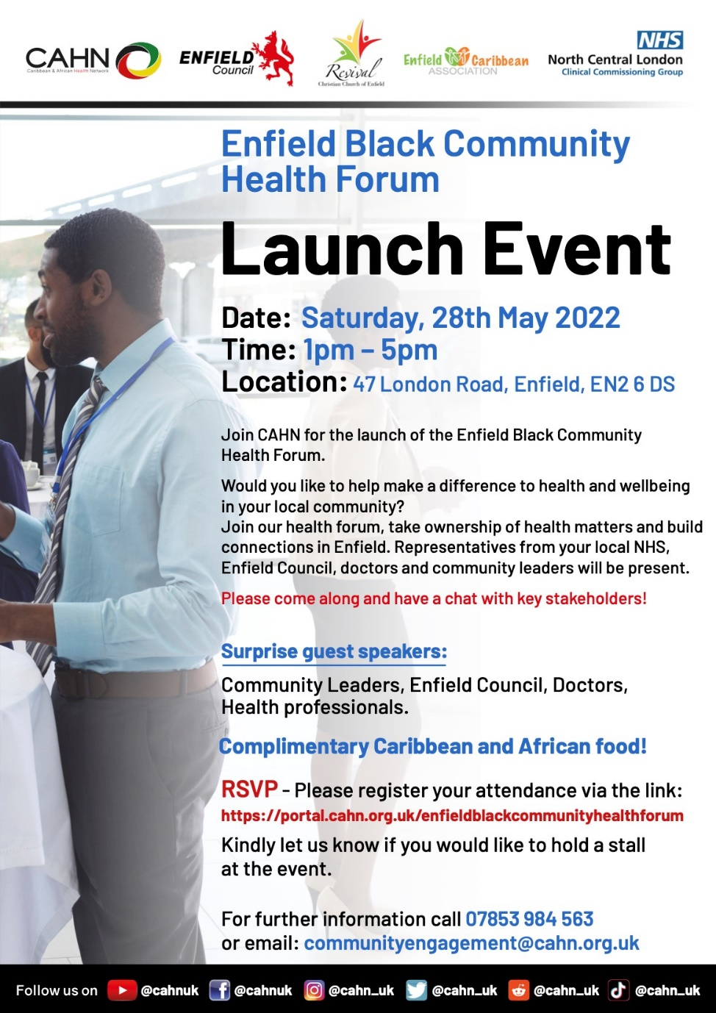
Enfield Black Community Health Forum

